Slide 1
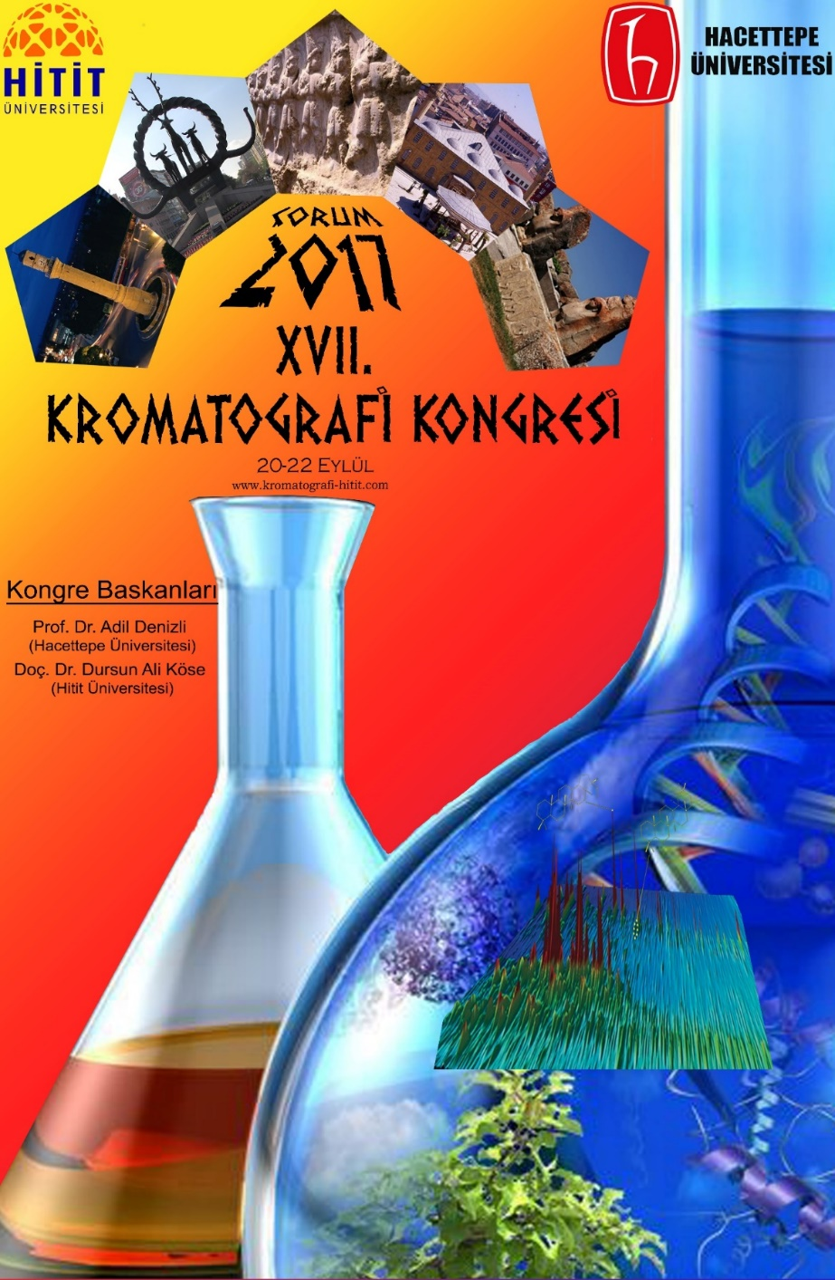
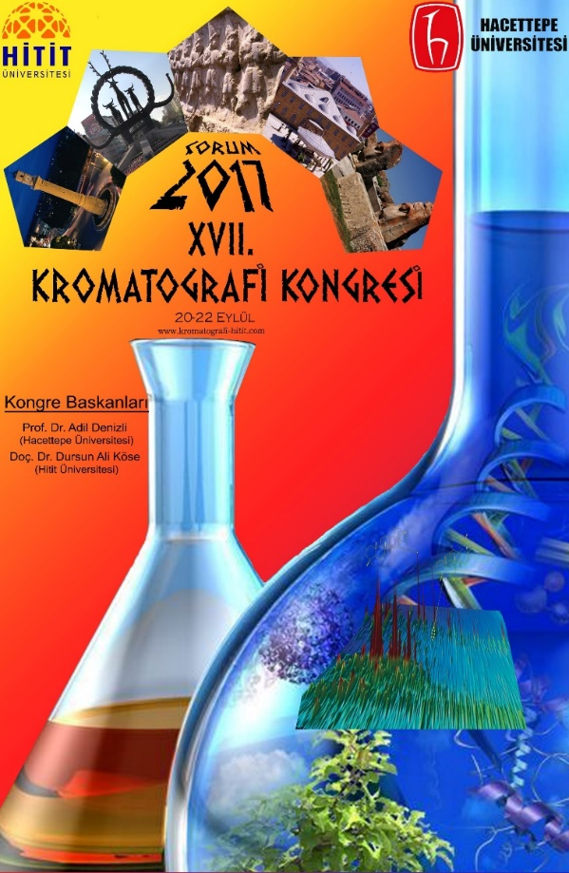
17th Ulusal Kromatografi Kongresi – KROMATOGRAFİˈ17
KROMATOGRAFİˈ17, Eylül 20 – 22, 2017, ÇORUM
70 x 100 cm Poster: Poster Başlığı
Adı Soyadı¹, Adı Soyadı², Adı Soyadı³
Üniversitesi, Bölüm, Şehir, Ülke
email : xxx@xxxx
Giriş
This example is to demonstrate the layout of an example poster for presentation at the Conference. The purpose of poster paper presentation is to promote informal discussion. It is a graphic display of a written manuscript. The poster presentation stands by itself as a summary of research and usually contains an overview of research objectives, experimental methods, materials, results and a discussion.
The organisers of the ICOEST’13 are committed to providing a high-calibre program and urge you to consider the preparation of your poster carefully. You are encouraged to make full use of your available space. Posters are not intended as a mechanism for advertising products or services. Posters consisting of commercial brochures describing products or services or that are not of appropriate quality may be rejected on-site.
Şekil 1. XXXXXXX
Şekil 2. XXXXXXXX
Sonuçlar
Fill with text. Fill with text. Fill with text. Fill with text. Fill with text. Fill with text. Fill with text. Fill with text. Fill with text. Fill with text. Fill with text. Fill with text. Fill with text. Fill with text. Fill with text. Fill with text. Fill with text. Fill with text. Fill with text. Fill with text. Fill with text. Fill with text. Fill with text. Fill with text. Fill with text. Fill with text. Fill with text. Fill with text. Fill with text. Fill with text. Fill with text.
Fill with text. Fill with text. Fill with text. Fill with text. Fill with text. Fill with text. Fill with text. Fill with text. Fill with text. Fill with text. Fill with text. Fill with text. Fill with text. Fill with text. Fill with text. Fill with text. Fill with text. Fill with text. Fill with text. Fill with text. Fill with text. Fill with text. Fill with text. Fill with text. Fill with text. Fill with text. Fill with text.
Fill with text. Fill with text. Fill with text. Fill with text. Fill with text. Fill with text. Fill with text. Fill with text. Fill with text. Fill with text. Fill with text. Fill with text. Fill with text. Fill with text. Fill with text. Fill with text. Fill with text. Fill with text. Fill with text. Fill with text. Fill with text. Fill with text.
Şekil 3. XXXXXXX
Fill with text. Fill with text. Fill with text. Fill with text. Fill with text. Fill with text. Fill with text. Fill with text. Fill with text. Fill with text. Fill with text. Fill with text. Fill with text. Fill with text. Fill with text. Fill with text. Fill with text. Fill with text. Fill with text. Fill with text. Fill with text. Fill with text. Fill with text. Fill with text. Fill with text. Fill with text. Fill with text. Fill with text. Fill with text. Fill with text. Fill with text.
Fill with text. Fill with text. Fill with text. Fill with text. Fill with text. Fill with text. Fill with text. Fill with text. Fill with text. Fill with text. Fill with text. Fill with text. Fill with text. Fill with text. Fill with text. Fill with text. Fill with text. Fill with text. Fill with text. Fill with text. Fill with text. Fill with text. Fill with text. Fill with text. Fill with text. Fill with text. Fill with text.
Fill with text. Fill with text. Fill with text. Fill with text. Fill with text. Fill with text. Fill with text. Fill with text. Fill with text. Fill with text. Fill with text. Fill with text. Fill with text. Fill with text. Fill with text. Fill with text. Fill with text. Fill with text. Fill with text. Fill with text. Fill with text. Fill with text.
Tablo 1. XXXXXX
XXXX (W/mL) | Protein (mg/L) | XXXXX (mg/L) | sCOD (mg/L) | DD_{COD} (%)
1.0 | 500 | 340 | 950 | 23
1.5 | 850 | 560 | 1490 | 32
Sonuçlar
Sonuçlar
Teşekkür
KROMATOGRAFİˈ17- Çorum 2017

